Slide 1

Hash Table & Dictionaries

Slide 2
Dictionary ADT
Models a searchable collection of key-element items called entries
Main operations: find, insert, remove
findElement(k), insertItem(k, o), removeElement(k)
size(), isEmpty()
keys(), elements()
Applications:
address book
word-definition pairs
mapping host names to internet addresses (e.g., www.cs16.net to 128.148.34.101)

Slide 3
Hash Table -based Dictionaries
Hashing can be used to build, search, store or delete from a table/Dictionary
Ex. Java hashmap , Python dictionary
Advantages of Hashing:
O(1) time for data storing and retrieval.

Slide 4
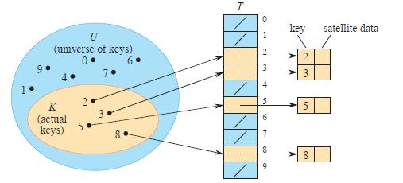
Hash Functions and Hash Tables
A hash table for a given key type consists of
Array (called table) of size N
Hash function h
A hash function h maps keys of a given type to integers in a fixed interval [0, N - 1]
Ex: h(x) = x mod N is a hash function for integer keys
The integer h(x) is called the hash value of key x
When implementing a dictionary with a hash table, the goal is to store item (k, o) at index i = h(k)
Direct hashing h(x) =x

Slide 5
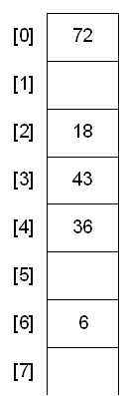
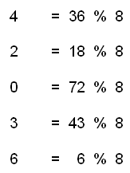
Hash Functions and Hash Tables
A hash table for a given key type consists of
Array (called table) of size N
Hash function h
A hash function h maps keys of a given type to integers in a fixed interval [0, N - 1]
Ex: h(x) = x mod N is a hash function for integer keys
The integer h(x) is called the hash value of key x
When implementing a dictionary with a hash table, the goal is to store item (k, o) at index i = h(k)
Example:
Table size N=8
h(x) = x mod N
= x % 8

Slide 6
Example
Hash table
We design a hash table for a dictionary storing items (social security number, name)
0
1
2
3
4
0
025-61-0001
981-10-0002
0
451-22-0004
Our hash table uses an array of size N = 10,000 and the hash function h(x) = last four digits of x
…
9997
9998
9999
0
200-75-9998
0
Hash value h(x)
Keys x

Slide 7
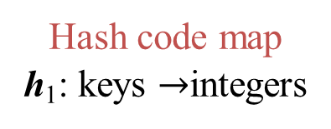
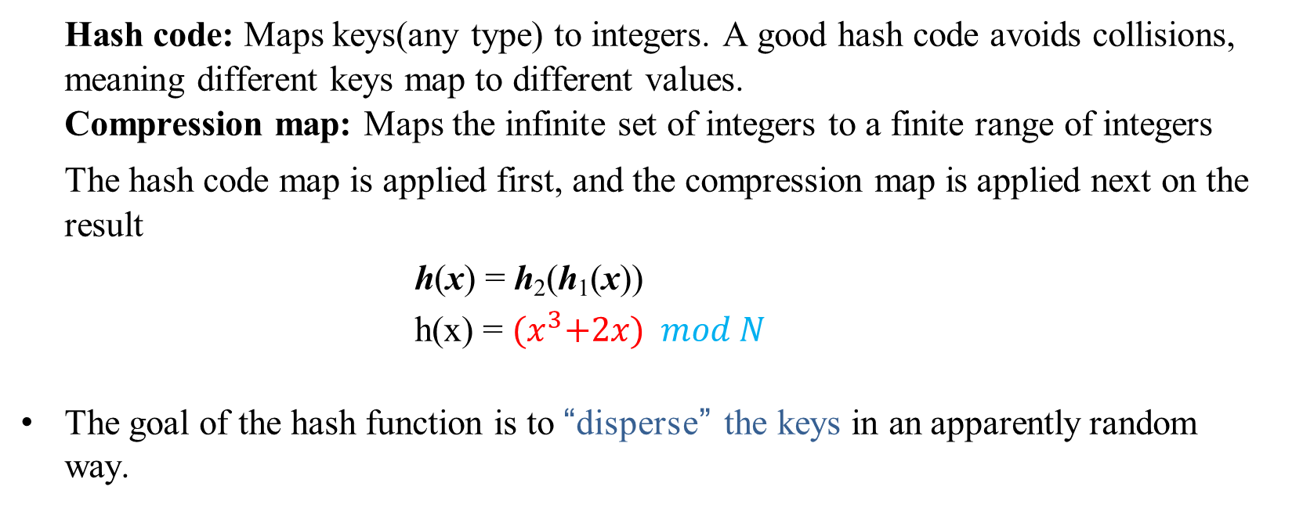
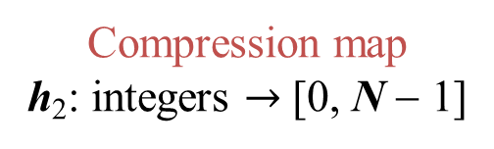
Hash Functions
A hash function is usually specified as the composition of two functions:
Hash code map
h₁: keys $→$integers
Compression map
h₂: integers $→$ [0, N − 1]
Hash code: Maps keys(any type) to integers. A good hash code avoids collisions, meaning different keys map to different values.
Compression map: Maps the infinite set of integers to a finite range of integers
The hash code map is applied first, and the compression map is applied next on the result
h(x) = h₂(h₁(x))
h(x) = ${(x}^{3}+2x) mod N$
The goal of the hash function is to “disperse” the keys in an apparently random way.
h₁
h₂

Slide 8

Hash Code Maps: keys $→$integers
Memory address
reinterpret the memory address of the key object as an integer
default hash code of Java objects
disadvantage: two key objects with equal value have different hash codes
Integer cast
reinterpret bits of the key as an integer
suitable for smaller keys (when number of bits in the key is at most the number of bits in an integer)
Dictionaries & Hash Tables

Slide 9
Hash Code Maps: keys $→$ integers
Component sum
suitable for larger keys
partition bits of the key into components of fixed length and sum the components
disadvantage: many strings will have the same sum
h₁(k) = a₀ + a₁ + a₂ + … + a_{n−1}
Polynomial accumulation
good for strings
partition bits of the key into components of fixed length and evaluate the polynomial
h₁(k) = a₀ + a₁ z + a₂ z² + … + a_{n−1}z^{n−1}
Ex. h1(“dog”) = ASCII(‘d’) + ASCII(‘o’) + ASCII(‘g’)
= 100 + 111 + 314 = 314
h1(“god”) = 314 - Different values expected, h1 is not good
With the value of z = 3:
Ex. h1(“dog”) = ASCII(‘d’) + ASCII(‘o’)*3 + ASCII(‘g’)*9
= 100 + 111*3 + 314*9 = 1336
h1(“god”) = 1360 Different!!!
Dictionaries & Hash Tables

Slide 10
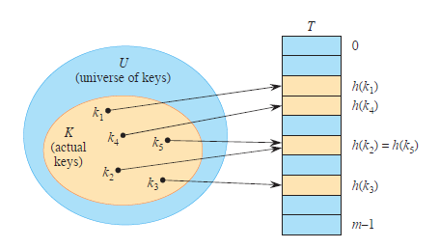
Collision
If two keys resolve to the same hash key, it is known as a collision.

Slide 11
Compression Maps: integers $→$ [0,Ν−1]
A good hash function guarantees the probability that two different keys have the same hash is 1/N.
The size N of the hash table is usually chosen to be a prime.
– The reason involves number theory and is beyond the scope of this course
Division
h₂ (y) = y mod N
disadvantage: repeated keys of the form iN + j cause collisions
Multiply, Add and Divide (MAD)
h₂ (y) = ((ay + b) mod p) mod N
This is a “good” hash function (continued next slide…)
7 = 2*3 +1
10= 3*3 + 1
19 = 6*3 + 1
With N=3, h2 will give same hash which is 1
Dictionaries & Hash Tables

Slide 12
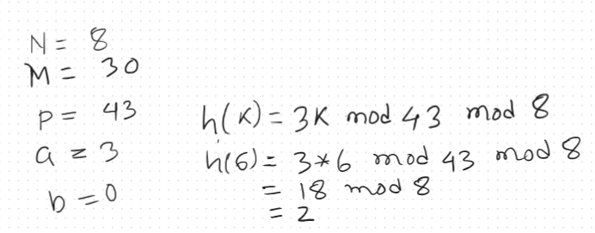
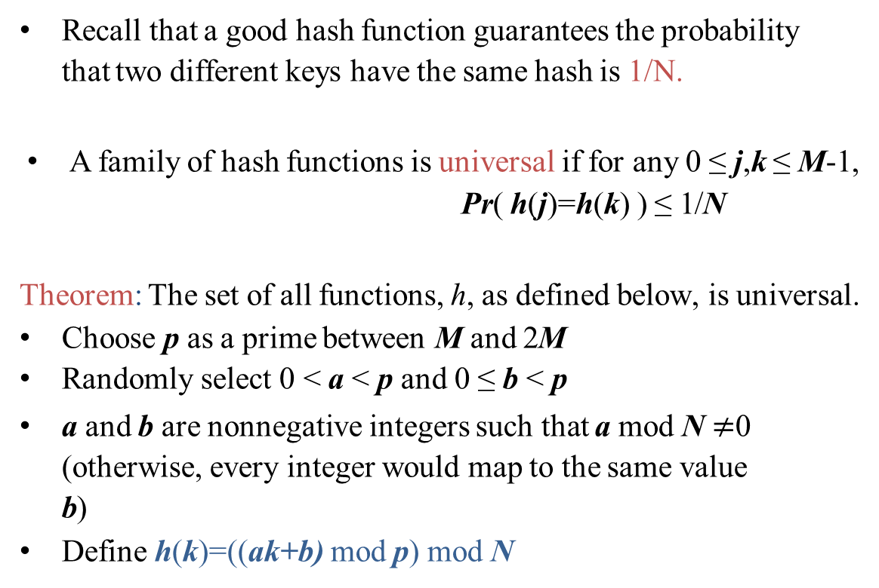
Universal Hashing
Recall that a good hash function guarantees the probability that two different keys have the same hash is 1/N.
A family of hash functions is universal if for any 0 ≤ j,k ≤ M-1,
Pr( h(j)=h(k) ) ≤ 1/N
Theorem: The set of all functions, h, as defined below, is universal.
Choose p as a prime between M and 2M
Randomly select 0 < a < p and 0 ≤ b < p
a and b are nonnegative integers such that a mod N $≠$0 (otherwise, every integer would map to the same value b)
Define h(k)=((ak+b) mod p) mod N

Slide 13
Collision Handling
Collisions occur when different elements are mapped to the same cell No matter which function you select. Still collision possible
Separate Chaining
each cell in the table points to a linked list of elements that map there
simple, but requires additional memory outside the table.
0
1
2
3
4
0
025-61-0001
0
0
451-22-0004
981-10-0004
Open Addressing
the colliding item is placed in a different cell of the table
no additional memory, but complicates searching/removing
common types: linear probing, quadratic probing, double hashing

Slide 14
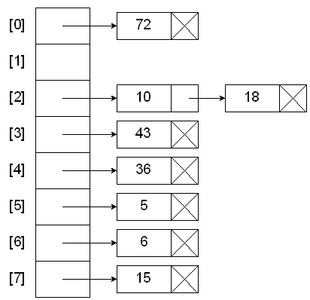
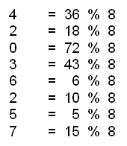
Separate Chaining
each cell in the table points to a linked list of elements that map there
elements with the same hash key will be chained together
simple, but requires additional memory outside the table
Example:
Table size N=8
h(x) = x mod N
= x % 8
Source: https://faculty.cs.niu.edu/~freedman/340/340notes/340hash.htm

Slide 15
Open Addressing: Linear Probing
Placing the colliding item in the next (circularly) available table cell try A[(h(k) + i) mod N] for i = 0,1,2,…
Colliding items cluster together, causing future collisions to cause a longer sequence of probes (searches for next available cell)
Example:
h(x) = x mod 13
Insert keys 18, 41, 22, 44, 59, 32, 31, 73, in this order
h(18) = 18 mod 13 = 5
41 mod 13 = 2
22 mod 13 = 9
44 mod 13 = 5
59 mod 13 = 7
32 mod 13 = 6
31 mod 13 = 5
73 mod 13 = 8
0 1 2 3 4 5 6 7 8 9 10 11 12
 |  |  |  |  | 18
0 1 2 3 4 5 6 7 8 9 10 11 12

Slide 16
Open Addressing: Linear Probing
Placing the colliding item in the next (circularly) available table cell try A[(h(k) + i) mod N] for i = 0,1,2,…
Colliding items cluster together, causing future collisions to cause a longer sequence of probes (searches for next available cell)
Example:
h(x) = x mod 13
Insert keys 18, 41, 22, 44, 59, 32, 31, 73, in this order
h(18) = 18 mod 13 = 5
41 mod 13 = 2
22 mod 13 = 9
44 mod 13 = 5
59 mod 13 = 7
32 mod 13 = 6
31 mod 13 = 5
73 mod 13 = 8
0 1 2 3 4 5 6 7 8 9 10 11 12
 |  | 41 |  |  | 18
0 1 2 3 4 5 6 7 8 9 10 11 12

Slide 17
Open Addressing: Linear Probing
Placing the colliding item in the next (circularly) available table cell try A[(h(k) + i) mod N] for i = 0,1,2,…
Colliding items cluster together, causing future collisions to cause a longer sequence of probes (searches for next available cell)
Example:
h(x) = x mod 13
Insert keys 18, 41, 22, 44, 59, 32, 31, 73, in this order
h(18) = 18 mod 13 = 5
41 mod 13 = 2
22 mod 13 = 9
44 mod 13 = 5
59 mod 13 = 7
32 mod 13 = 6
31 mod 13 = 5
73 mod 13 = 8
0 1 2 3 4 5 6 7 8 9 10 11 12
 |  | 41 |  |  | 18 |  |  |  | 22
0 1 2 3 4 5 6 7 8 9 10 11 12

Slide 18
Open Addressing: Linear Probing
Placing the colliding item in the next (circularly) available table cell try A[(h(k) + i) mod N] for i = 0,1,2,…
Colliding items cluster together, causing future collisions to cause a longer sequence of probes (searches for next available cell)
Example:
h(x) = x mod 13
Insert keys 18, 41, 22, 44, 59, 32, 31, 73, in this order
h(18) = 18 mod 13 = 5
41 mod 13 = 2
22 mod 13 = 9
44 mod 13 = 5
59 mod 13 = 7
32 mod 13 = 6
31 mod 13 = 5
73 mod 13 = 8
0 1 2 3 4 5 6 7 8 9 10 11 12
 |  | 41 |  |  | 18 | 44 |  |  | 22
0 1 2 3 4 5 6 7 8 9 10 11 12

Slide 19
Open Addressing: Linear Probing
Placing the colliding item in the next (circularly) available table cell try A[(h(k) + i) mod N] for i = 0,1,2,…
Colliding items cluster together, causing future collisions to cause a longer sequence of probes (searches for next available cell)
Example:
h(x) = x mod 13
Insert keys 18, 41, 22, 44, 59, 32, 31, 73, in this order
h(18) = 18 mod 13 = 5
41 mod 13 = 2
22 mod 13 = 9
44 mod 13 = 5
59 mod 13 = 7
32 mod 13 = 6
31 mod 13 = 5
73 mod 13 = 8
0 1 2 3 4 5 6 7 8 9 10 11 12
 |  | 41 |  |  | 18 | 44 | 59 |  | 22
0 1 2 3 4 5 6 7 8 9 10 11 12

Slide 20
Open Addressing: Linear Probing
Placing the colliding item in the next (circularly) available table cell try A[(h(k) + i) mod N] for i = 0,1,2,…
Colliding items cluster together, causing future collisions to cause a longer sequence of probes (searches for next available cell)
Example:
h(x) = x mod 13
Insert keys 18, 41, 22, 44, 59, 32, 31, 73, in this order
h(18) = 18 mod 13 = 5
41 mod 13 = 2
22 mod 13 = 9
44 mod 13 = 5
59 mod 13 = 7
32 mod 13 = 6
31 mod 13 = 5
73 mod 13 = 8
0 1 2 3 4 5 6 7 8 9 10 11 12
 |  | 41 |  |  | 18 | 44 | 59 | 32 | 22 | 31 | 73
0 1 2 3 4 5 6 7 8 9 10 11 12

Slide 21
Search with Linear Probing
Consider a hash table A that uses linear probing
Algorithm findElement(k)
i ← h(k) p ← 0 repeat
c ← A[i]
if c = 0
return NO_SUCH_KEY
else if c.key () = k
return c.element()
else
i ← (i + 1) mod N p ← p + 1
until p = N
return NO_SUCH_KEY
findElement(k)
Start at cell h(k)
Check consecutive locations until one of the following occurs
An item with key k is found, or
An empty cell is found, or
N cells have been unsuccessfully probed
//Empty
//Unsuccessful and the table is full

Slide 22
Updates with Linear Probing
A special object, called AVAILABLE, replaces deleted elements
removeElement(k)
Search for an item with key k
If it is found, replace it with item AVAILABLE and return element
Else, return NO_SUCH_KEY
insertItem(k, o)
Throw an exception if the table is full
Start at cell h(k)
Search consecutive cells until a cell i is found that is either empty or stores AVAILABLE
Store item (k, o) in cell i
AVAILABLE
 |  | 41 |  |  | 18 | 44 | 59 | 32 | 22 | 31 | 73
0 1 2 3 4 5 6 7 8 9 10 11 12

Slide 23
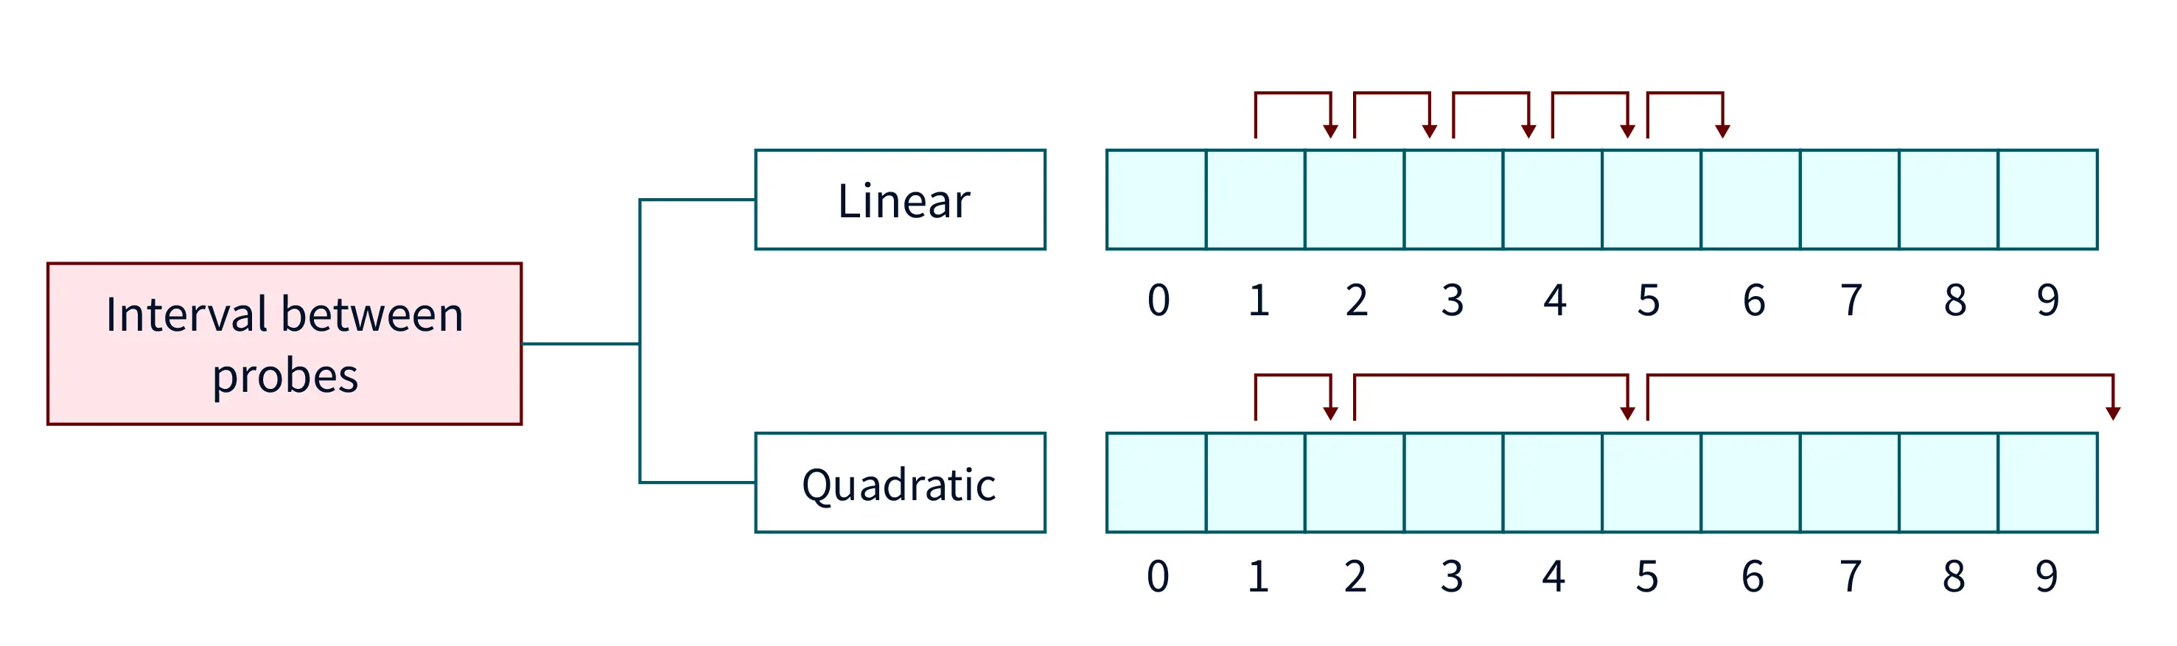
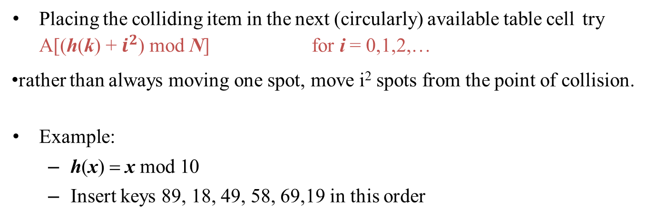
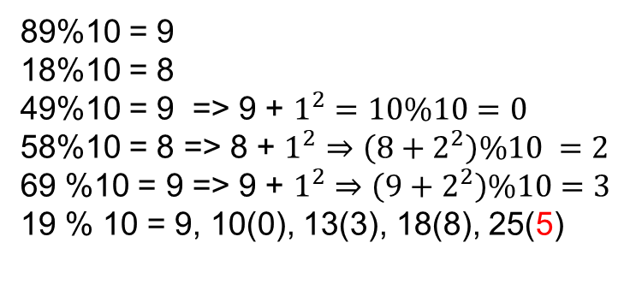
Open Addressing: Quadratic Probing
Placing the colliding item in the next (circularly) available table cell try A[(h(k) + $i^{2}$) mod N] for i = 0,1,2,…
rather than always moving one spot, move i² spots from the point of collision.
Example:
h(x) = x mod 10
Insert keys 89, 18, 49, 58, 69,19 in this order
49 |  | 58 | 69 |  | 19 |  |  | 18 | 89
0 | 1 | 2 | 3 | 4 | 5 | 6 | 7 | 8 | 9
89%10 = 9
18%10 = 8
49%10 = 9 => 9 + $1^{2}=10\%10=0$
58%10 = 8 => 8 + $1^{2}⇒\left(8+2^{2}\right)\%10 =2$
69 %10 = 9 => 9 + $1^{2}⇒\left(9+2^{2}\right)\%10=3$
19 % 10 = 9, 10(0), 13(3), 18(8), 25(5)
source

Slide 24
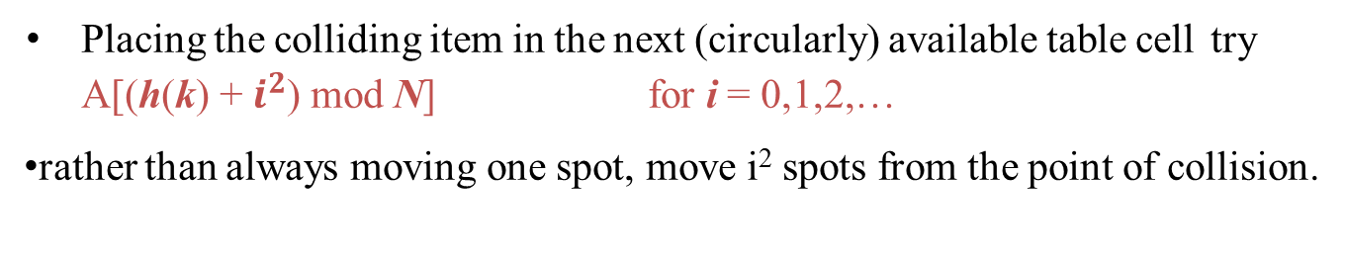
Open Addressing: Quadratic Probing
Placing the colliding item in the next (circularly) available table cell try A[(h(k) + $i^{2}$) mod N] for i = 0,1,2,…
rather than always moving one spot, move i² spots from the point of collision.
49 |  | 58 | 69 |  |  |  |  | 18 | 89
0 | 1 | 2 | 3 | 4 | 5 | 6 | 7 | 8 | 9
Limitation:
at most half of the table can be used as alternative locations to resolve collisions.
This means that once the table is more than half full, it's difficult to find an empty spot.
This new problem is known as secondary clustering because elements that hash to the same hash key will always probe the same alternative cells.

Slide 25
Open Addressing: Double Hashing
Use a secondary hash function d(k) to place items in first available cell try A[(h(k) + id(k)) mod N] for i = 0,1,2,…
d(k) cannot have zero values
The table size N must be a prime to allow probing of all the cells

Slide 26
Example of Double Hashing
Consider a hash table storing integer keys that handles collision with double hashing
– N = 13
h(k) = k mod 13
d(k) = 1 + (k mod 7)
Insert keys 18, 41, 22, 44, 59, 32, 31, 73, in this order
A[(h(k) + id(k)) mod N] for i = 0,1,2,…
k | h (k ) | d (k ) | Prob | es
18 | 5 | 5 | 5
41 | 2 | 7 | 2
22 | 9 | 2 | 9
44 | 5 | 3 | 5 | 8
59 | 7 | 4 | 7
32 | 6 | 5 | 6
31 | 5 | 4 | 5 | 9 | 0
73 | 8 | 4 | 8 | 12
0 | 1 | 2 | 3 | 4 | 5 | 6 | 7 | 8 | 9 | 10 11 12
31 |  | 41 |  |  | 18 | 32 | 59 | 44 | 22 |  |  | 73
0 | 1 | 2 | 3 | 4 | 5 | 6 | 7 | 8 | 9 | 10 11 12

Slide 27
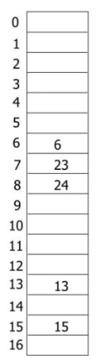
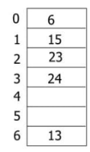
Rehashing
Once the hash table gets too full, the running time for operations will start to take too long and may fail.
Rehashing – make table size double and copy all the elements from old to the new table.
The new size of the hash table:
should also be prime
will be used to calculate the new insertion spot (hence the name rehashing)
This is a very expensive operation! O(N).
This is ok though since it doesn't happen that often.
When to rehash?
once the table becomes half full
once an insertion fails.
once a specific load factor has been reached, where load factor is the ratio of the number of elements in the hash table to the table size.
Rehashing
h(x)= x%6
h(x)= x%17

Slide 28
Performance of Hashing
A good hash function,
less collision- Evenly distributes the items throughout the hash table.
Easy to compute, constant time O(1)
Use the entire key to calculate hash value
For a given input, the hash function should always produce the same output.
For module arithmetic, use prime numbers.
Expected cost of hashing - insert, delete & search is O(1)

Slide 29
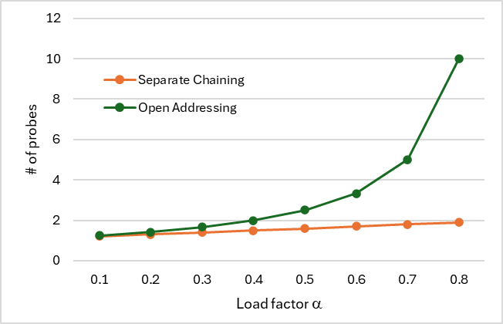
Performance of Hashing
The load factor α = n/N affects the performance of hashing
Searching cost ( insert, delete require searching a location):
Assuming that the hash values are like random numbers, it can be shown that the expected number of probes for an searching an item with open addressing is 1 / (1 − α)
( check the book for proof)
For Separate Chaining, the expected number of probes for an search an item is O(1 + α)

Slide 30
Performance of Hashing
The load factor α = n/N affects the performance of hashing
insertion cost:
open addressing: require 1 / (1 − α) searches on average
Rehashing will be worst. O(N), do when α >0.5
For Separate Chaining:
It is O(1) if you insert at the beginning of the list.
Rehash when α >1
The cost for deletion will be mainly for the searching
– no shifting in array

Slide 31
Chaining vs. Open Addressing
Chaining
Less sensitive to hash functions and load factor
Supports α > 1
0
1
2
3
4
0
a
0
0
b
c
Open Addressing
Requires careful selection of hash function to avoid clustering
Degrades past α > 0.7
Can’t support α > 1
Better memory usage
h(a) = 1
h(b) = 4
h(c) = 4
0
1
2
3
4
a
c
b
Dictionaries & Hash Tables

Slide 32
Disadvantages of Hashing
Following operations are expensive:
Finding the item with minimum or maximum search key.
Retrieving data in sorted order
Range query
Do not use hashing/HashMap if you have these operations in the ADT.
Dictionary does not require these operations.

Slide 33
Exercise
You are given an array A of integers. Determine the integer that occurs most frequently in A.
Hint: use a hashmap/python dictionary
Dictionaries & Hash Tables

